Slide 1

Rajesh K Jeyapaul
IBM
LinkedIn/Youtube - RajeshJeyapaul

Slide 2
Agenda
Need of the society and its response
2018 winners solution analysis
Github / Code pattern’s for you
Scope to leverage research papers
What could be an effective solution
2019 focus

Slide 3
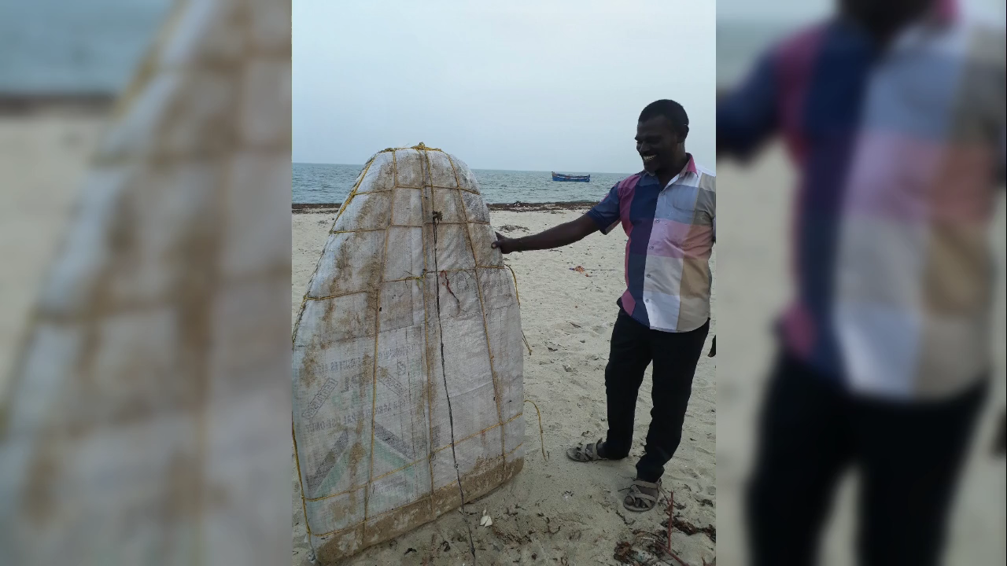

Slide 4
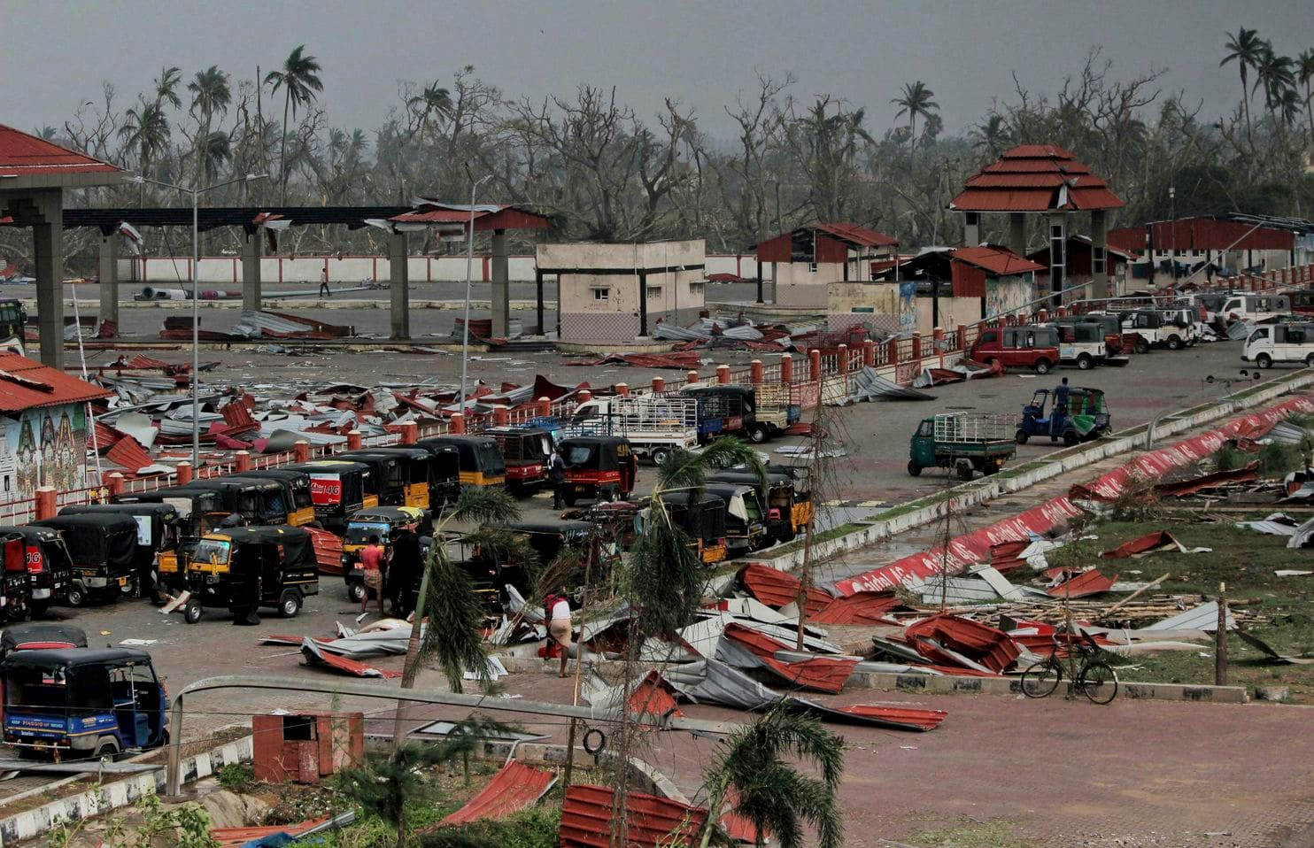
Commit to the Cause

Slide 5
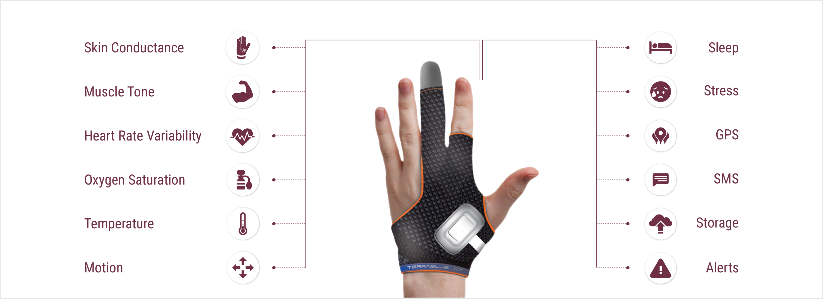
Push for Change- Mother Created Life Saving Device - TJay
Courtesy : https://www.teblux.com/tjay.html

Slide 6
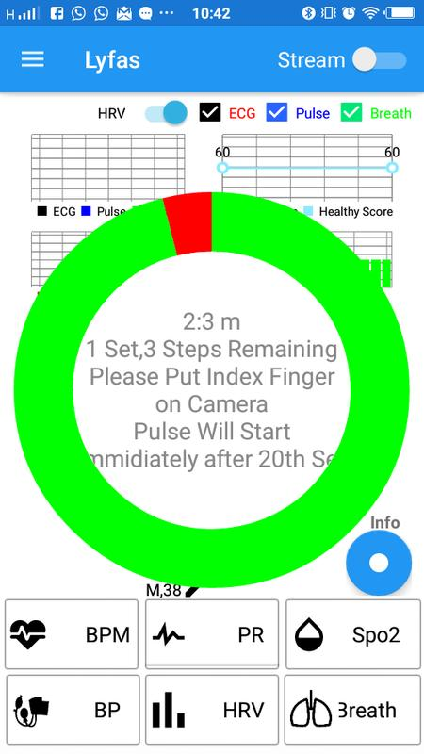
Push for Change
Lyfas - Non-Invasive Mobile Tool To Detect Heart Attack Risk

Slide 7
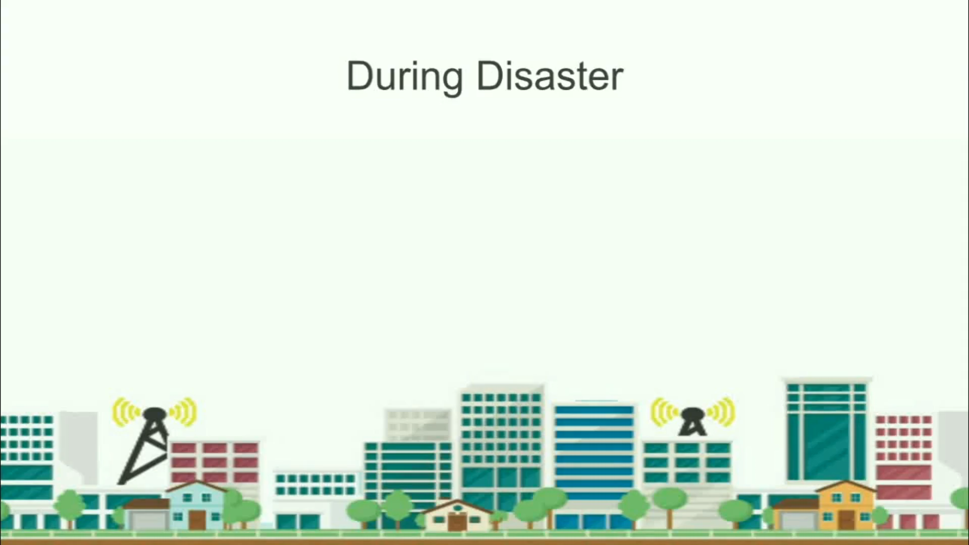
Answer the call

Slide 8
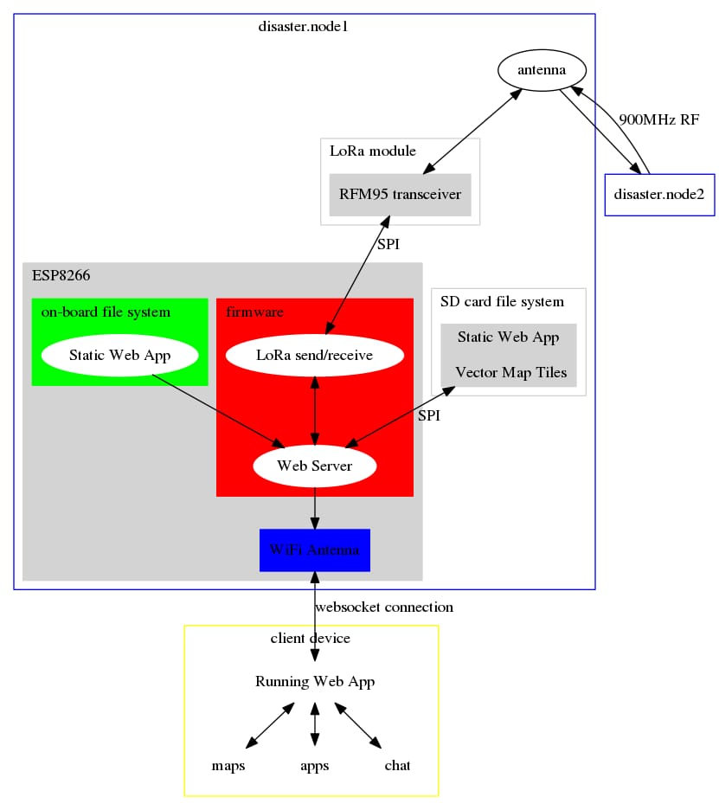
Answer the Call

Slide 9

2018 Winners solution analysis
-> Incident Management system to geo without active network
Two-part hardware/software solution.
-> provides an offline communication infrastructure
-> the OWL software incident management system, uses predictive analytics and multiple data sources to build a dashboard for first responders.
-> Project Owl is a Ruby on Rails web application hosted on IBM Cloud leveraging the IBM Watson Studio, IBM Watson Cloud APIs, Weather Company APIs, Google Maps API, and public data sets.
https://github.com/Project-Owl
Project OWL
https://developer.ibm.com/blogs/with-project-owl-a-smart-network-of-rubber-ducks-can-save-lives/

Slide 10
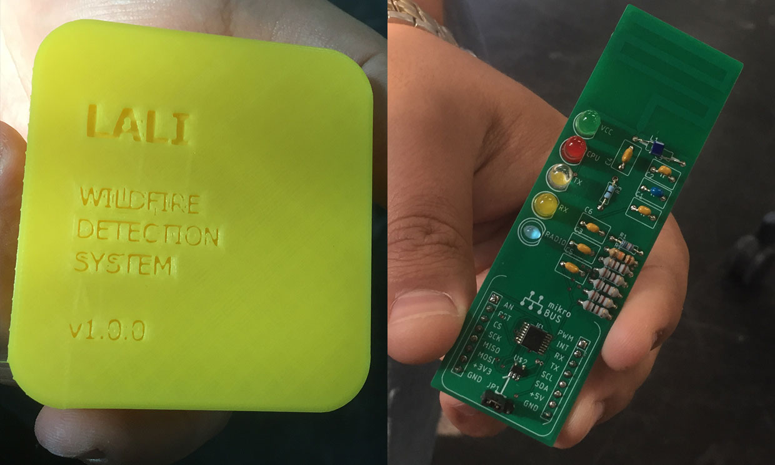
2018 Winners solution analysis
Project Lali predicts and detects wildfires with sensor networks
Using smart technology to leverage big data
->rapid mapping of affected areas and the extent of damage,
-> crowd sourced data – text , visual , geo information
->AI, ML, and data analytics can map potential hazards to enable proactive mitigation, all while keeping personally identifiable data protected.
-> IBM Cloud Hyper Protect Services can help you create and implement highly secure AI, ML, and data analytics solutions
https://spectrum.ieee.org/view-from-the-valley/at-work/start-ups/stopping-a-wildfire-with-a-lowcost-sensor-network

Slide 11
Solution Environment
System to avoid false alarm
Monitor Temperature
Communication provider (sigfox)
Cloud Processing
Cost / acre – 10$
Cost due to fire damage - $7000/acre
Monitor temp change and predict shape and path
https://spectrum.ieee.org/view-from-the-valley/at-work/start-ups/stopping-a-wildfire-with-a-lowcost-sensor-network

Slide 12
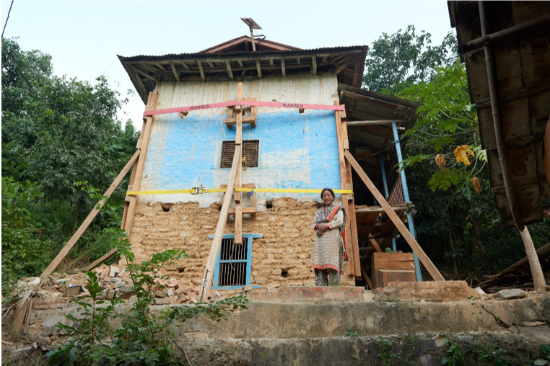
2018 Winners solution analysis
Post-Disaster Rapid Response Retrofit (PD3R)
-> Crowd source the damaged house images and also use Computer generated images for AI training
-> Use AI to identify the damages
-> Use additional software packages like Building Information Modelling Software, (BIM) to develop the retrofit design
-> Time saved from days to hours
https://github.com/Build-Change/call_for_code

Slide 13
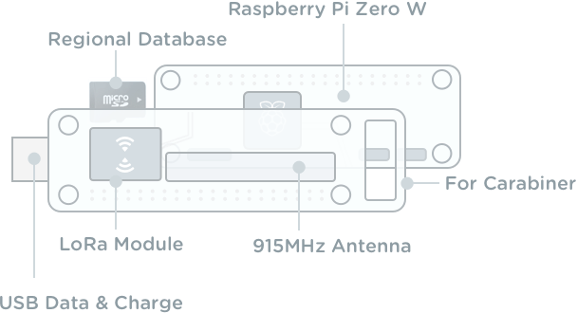
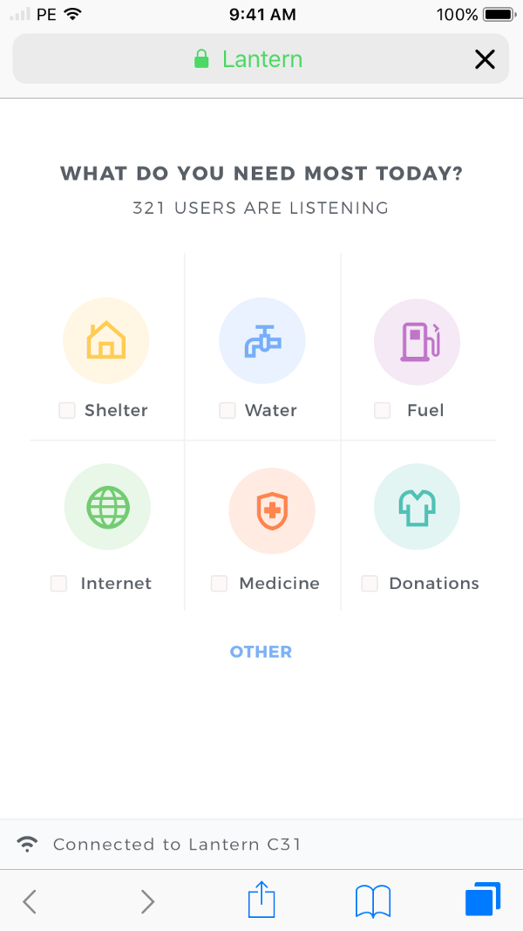
2018 Winners solution analysis
Project Lantern
-> collaboration between local volunteers, at risk populations and trained relief workers.
-> predicting the optimal distribution of supplies in affected areas
->Weather API , Cloudant , conversation service (bot)
->Real-time maps of disaster regions, travel routes
-> map tool to guide users to shelters, fresh waste and fuel, this solution is designed to keep communities organized
https://github.com/lantern-works

Slide 14
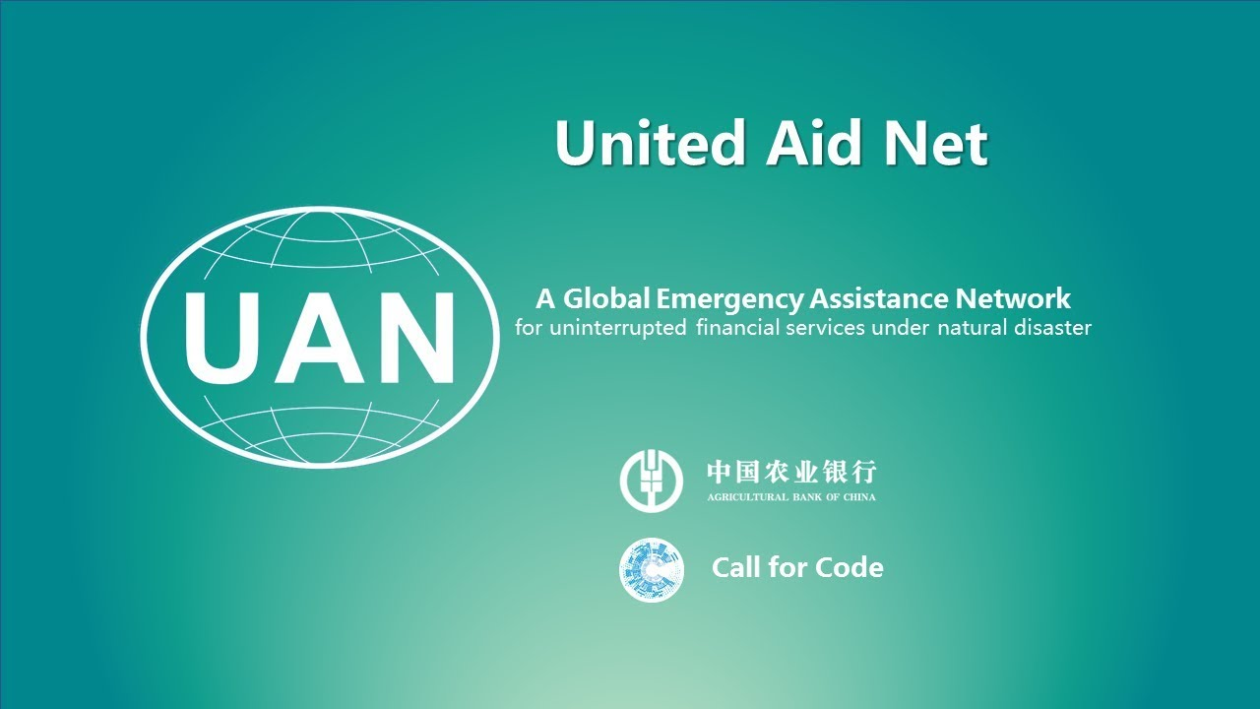
2018 Winners solution analysis
Green Coder – United Aid Net (UAN)
-> Problem: During an emergency, cash and credit cards can be lost and relatives can be separated, which leaves disaster victims without the money they may need.
-> UAN contains two networks: an institution network and a family network
-> identify family /friends through family network
-> Financial Institue joins the network
-> Beneficiaries withdraw money using face identification
-> Blockchain, Watson VR, Cloudant
https://developer.ibm.com/blogs/call-for-code-finalist-network-for-uninterrupted-financial-services/

Slide 15
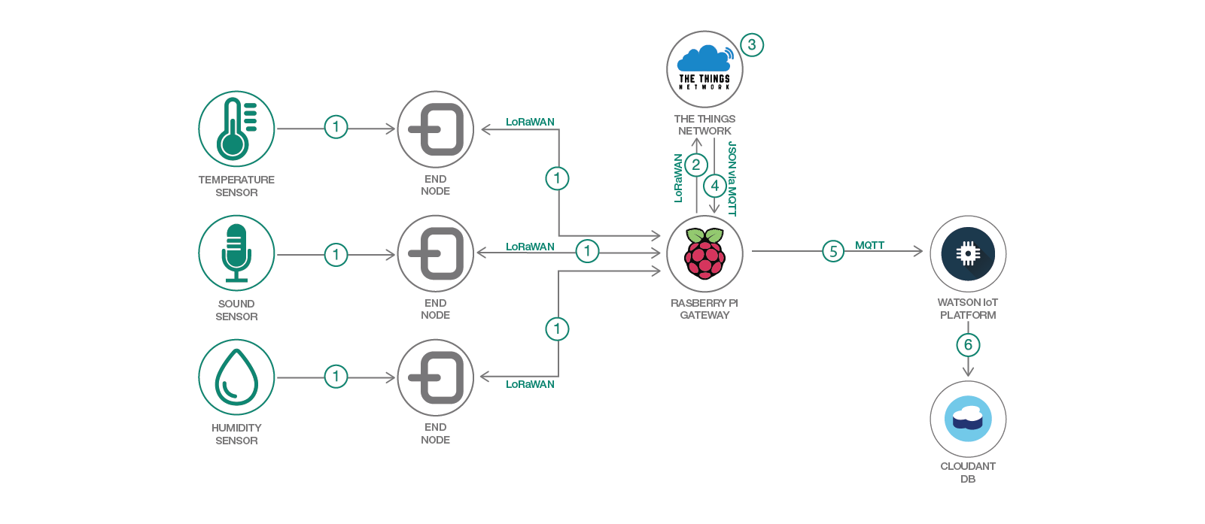
Solution Implementation quick reference - Code Patterns
https://developer.ibm.com/patterns/set-up-lorawan-iot-gateway-hardware/

Slide 16
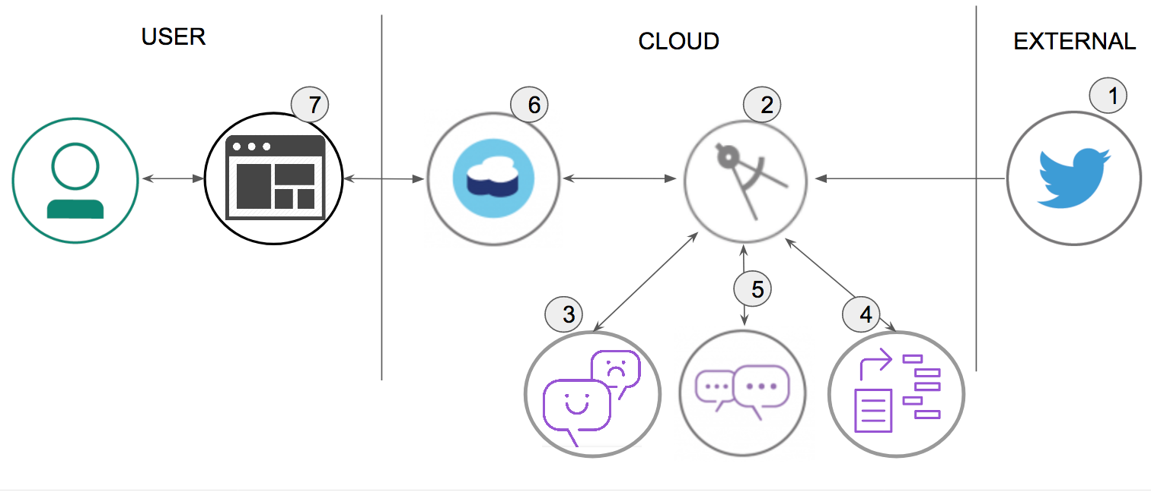
Stream and Analyze Tweets
Tweets are pushed out by Twitter.
The Cognitive Social CRM app (server.js) processes the tweet.
The Watson Tone Analyzer Service performs analysis of sentiment and emotional tone.
The Watson Natural Language Understanding Service pulls out keywords and entities.
The Watson Assistant Service extracts the intents (verbs) from the tweets.
Tweets and metadata are stored in Cloudant.
The Web UI displays charts and graphs as well as the tweets.

Slide 17
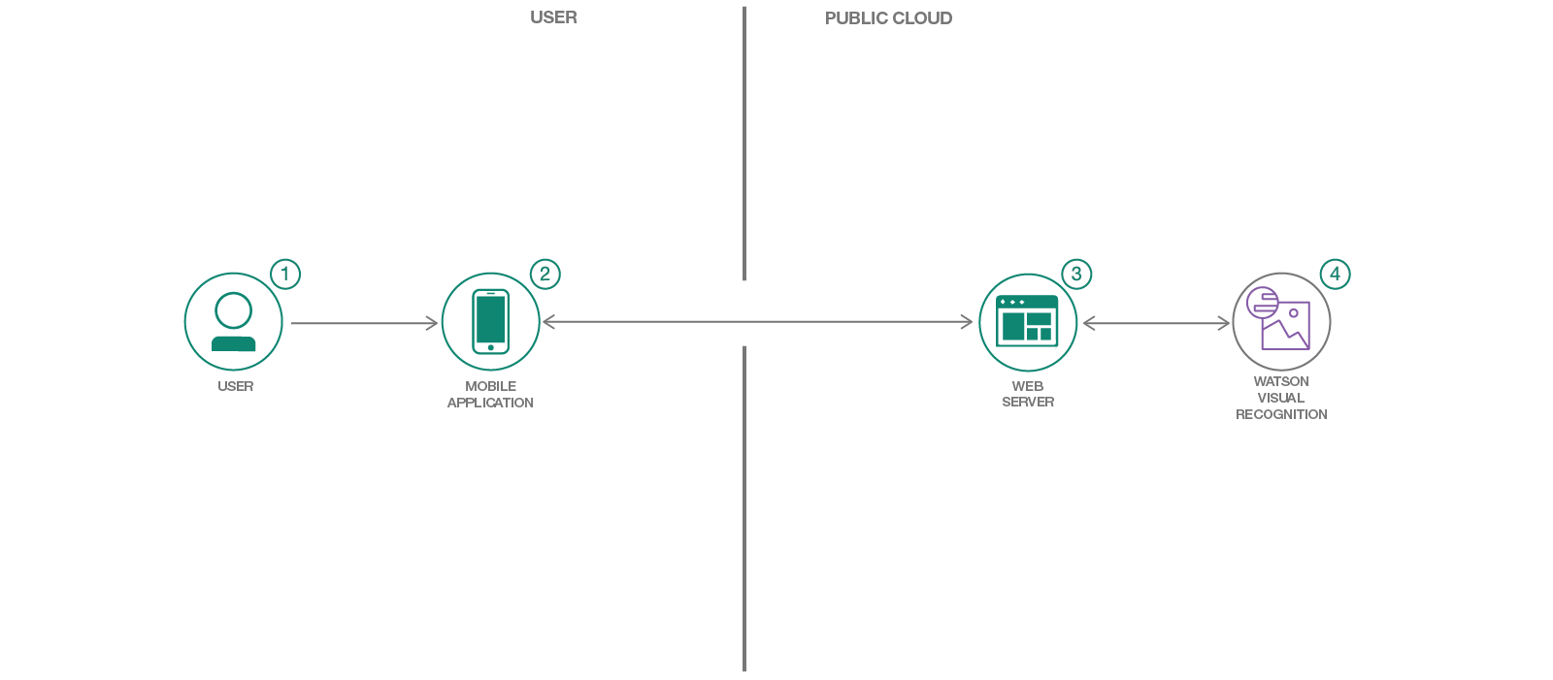
Visual Recognition To Process Claims Quickly
Create a Node.js server that can utilize the Watson Visual Recognition service for classifying images.
Have a server initialize a Visual Recognition custom classifier at startup.
Create a Visual Recognition custom classifier in an application.
Create an Android mobile application that can send pictures to a server app for classification using Visual Recognition.

Slide 18
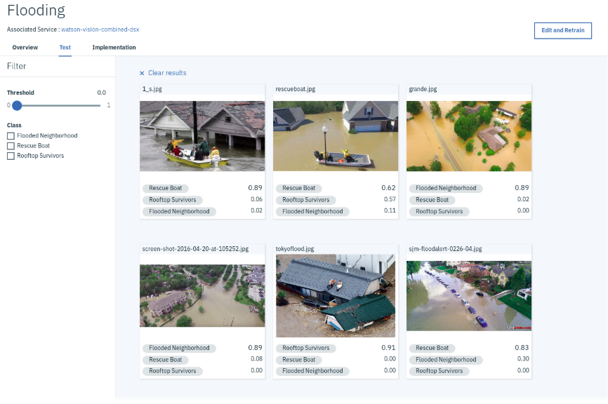
Drone Image classification
https://github.com/IBM/drones-iot-visual-recognition
https://github.com/blumareks/ai-visrec-under-10min

Slide 19
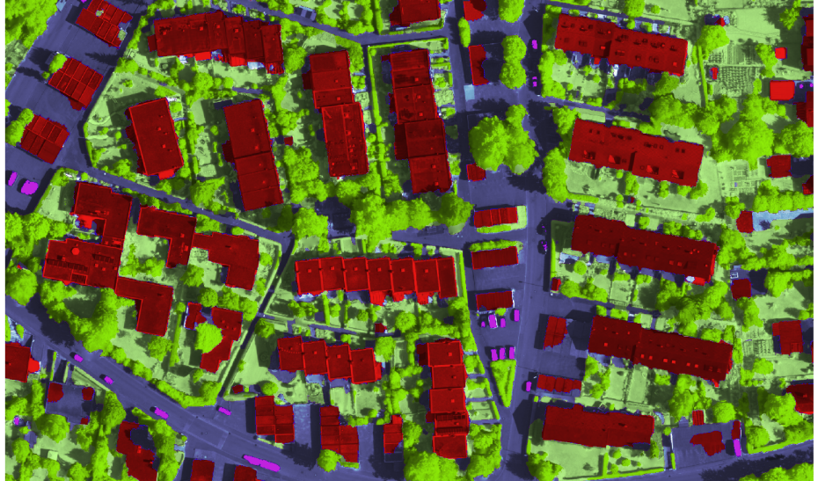
Image semantic segmentation
ESPNet based models good for realtime images !!
Usage for land coverage information.
Can be used for impact assessment , flood prediction etc.,
https://arxiv.org/abs/1803.06815

Slide 20
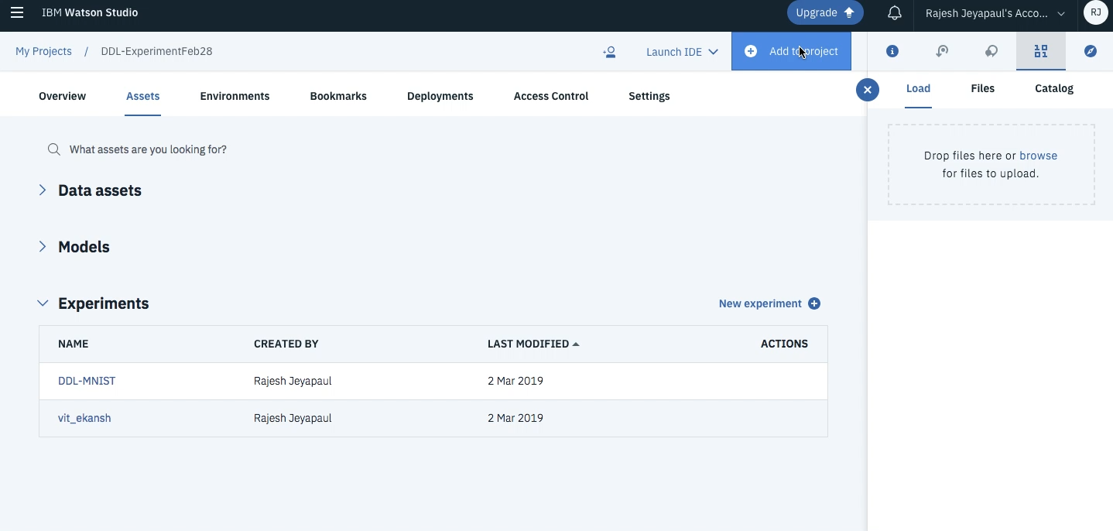
Deep learning model training - ”Experiment” @ Watson Studio

Slide 21
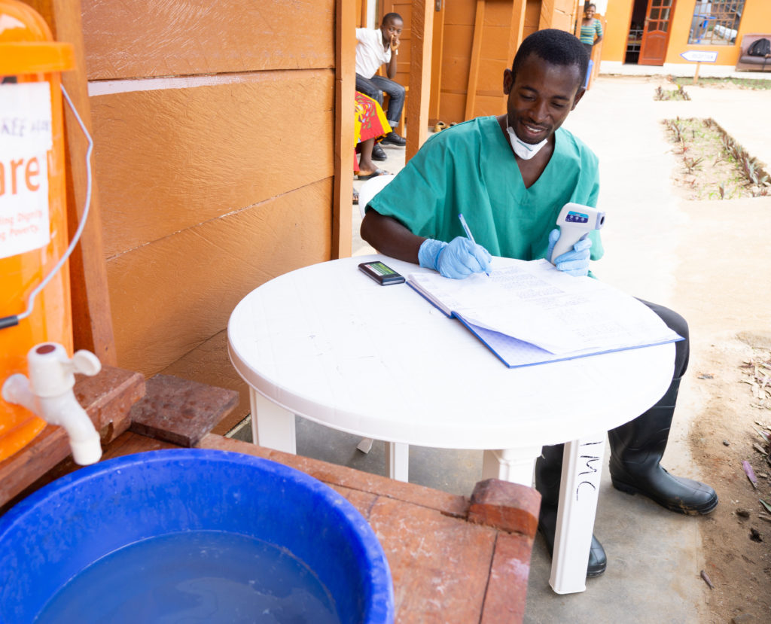
2019 – Emphasize is on healthcare
Water, Sanitation and Hygiene: Essential for Disease Control in Emergencies
!!
Water is critical to Ebola treatment,” recalls Dr. Adam Levine, an Ebola specialist and emergency medicine physician who helped lead the International Medical Corps response in West Africa. “With resources at the site being limited, and with trucking water into such a remote area very difficult, we had only one option. Before we could take in patients, we had to drill our own boreholes.”
https://internationalmedicalcorps.org/stories-and-news/

Slide 22
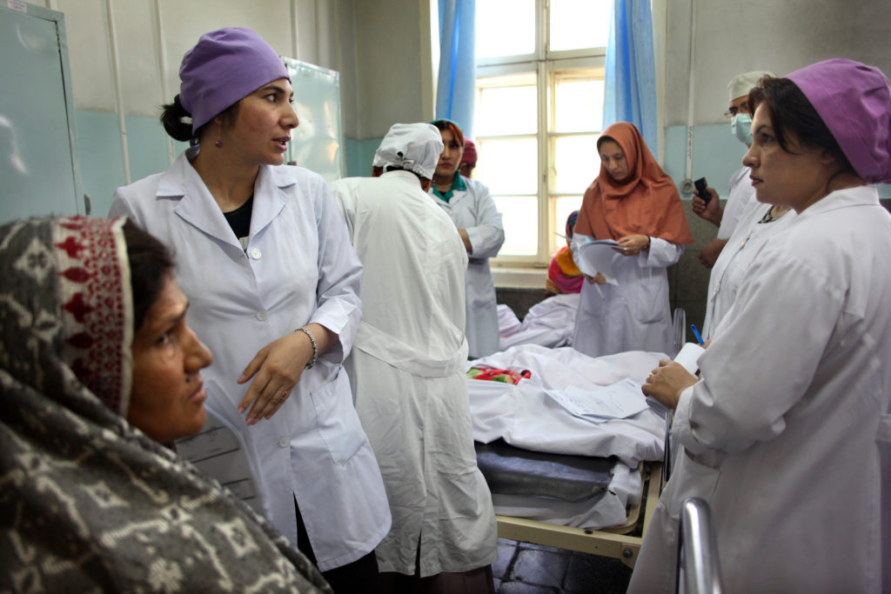
2019 – Emphasize is on healthcare
Midwives Matter – Provide first line Emergency care !!
midwives can make the difference between mothers and newborn babies thriving—or dying.
https://internationalmedicalcorps.org/stories-and-news/

Slide 23
2019 – Emphasize is on healthcare
Cholera Outbreak !!
When cholera starts spreading, it can be difficult to control. Outbreaks usually happen when a country’s health, hygiene, and water systems break down
The good news is that if people are treated quickly with rehydration solutions (and sometimes, antibiotics), cholera is survivable.
https://internationalmedicalcorps.org/stories-and-news/

Slide 24
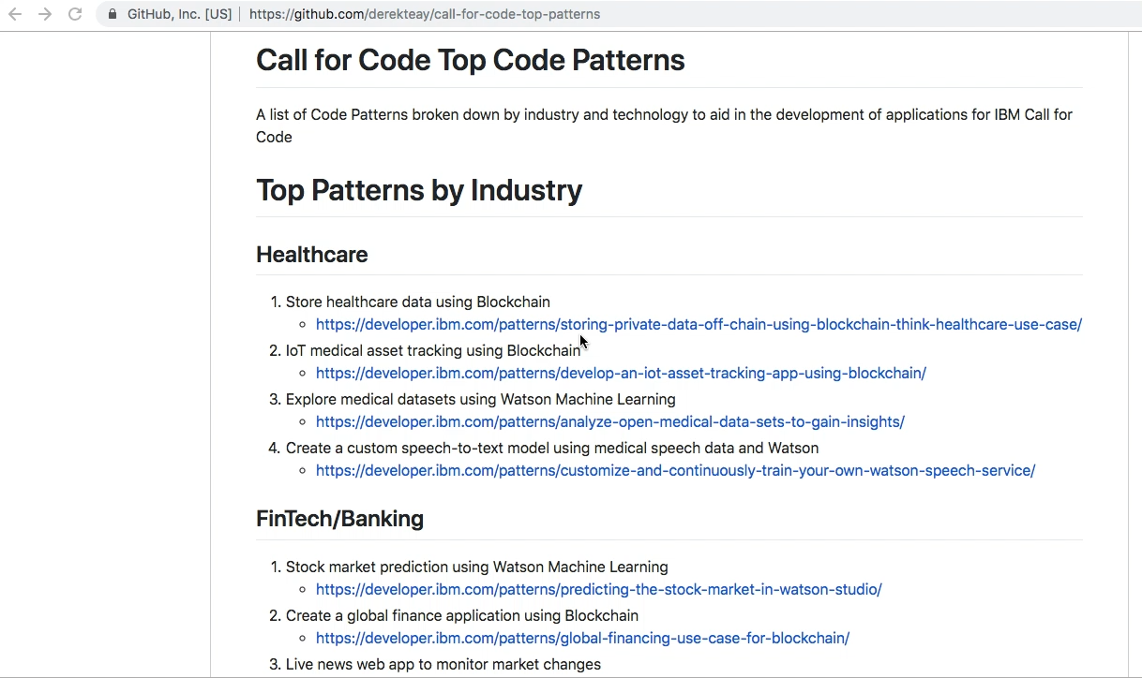
Key Code patterns -> https://github.com/derekteay/call-for-code-top-patterns

Slide 25
Practical , Effective and High quality Solution
Pattern from Last year submission:
-> Project Owl Trigger point -> Hardware and Software, Solution to First Responders
-> Project Post-Disaster Rapid Response Retrofit (PD3R)
-> Image classification solution supported by Computer Model. BIM , Houses in Nepal region has the capacity to retrofit
-> Project Lali -> Low cost , ability to predict shape and Path of wild fire
-> Lantern -> Hardware + Software, effective communication system for volunteers / First responders
-> Green Coder -> Blockchain based , Inclusive interms of including the responsible stakeholders to meet the need

Slide 26
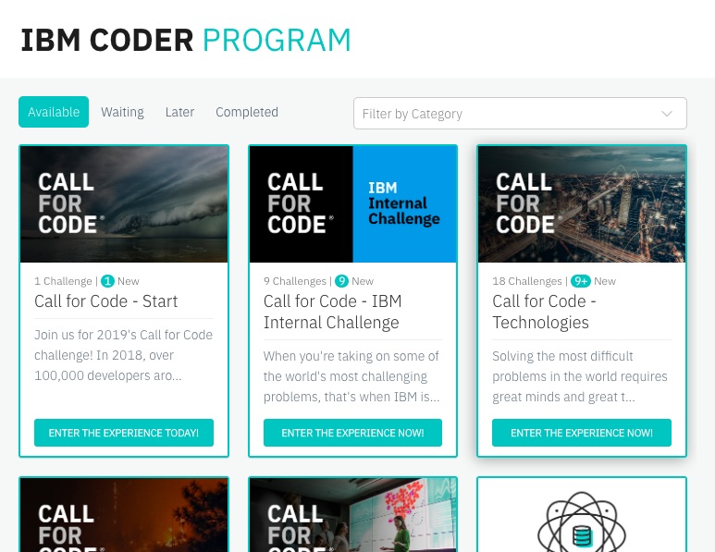
Next step – Register now > https://developer.ibm.com/callforcode/

Slide 27
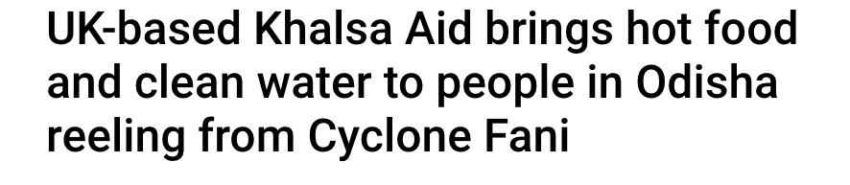
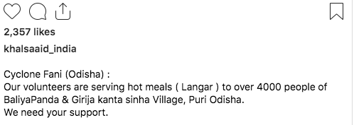
More than a Challenge – It is personal !!

Slide 28

Commit to the Cause, Push for change and Answer the call – Thank you !!

Slide 29
To train any deep learning Model - ”Experiment” @ Watson Studio

